Slide 1

Pneumonia Classification on X-rays using Convolutional Neural Networks
André Reis Fernandes, Nº 97977
Gonçalo Jorge Loureiro de Freitas, Nº 98012
Artificial Intelligence Applications - Prof: Petia Georgieva (petia@ua.pt) - Academic Year 2022/23

Slide 2
Outline
Data Overview
Model
Approach
Mini Project 1
Mini Project 2
Results
Conclusion
2

Slide 3
1
Data Overview
Understanding the data and an overview
3

Slide 4

The Data (1/3)
The dataset used in this project is the ‘Labeled Optical Coherence Tomography (OCT) and Chest X-Ray Images for Classification’ data set. The dataset consists in images of chest X-Ray images from persons with and without pneumonia.
4

Slide 5
The Data (2/3)
Already divided in training and testing
Each one divided in normal and pneumonia images
For the validation set it was used a 80:20 ratio in the training set
5

Slide 6
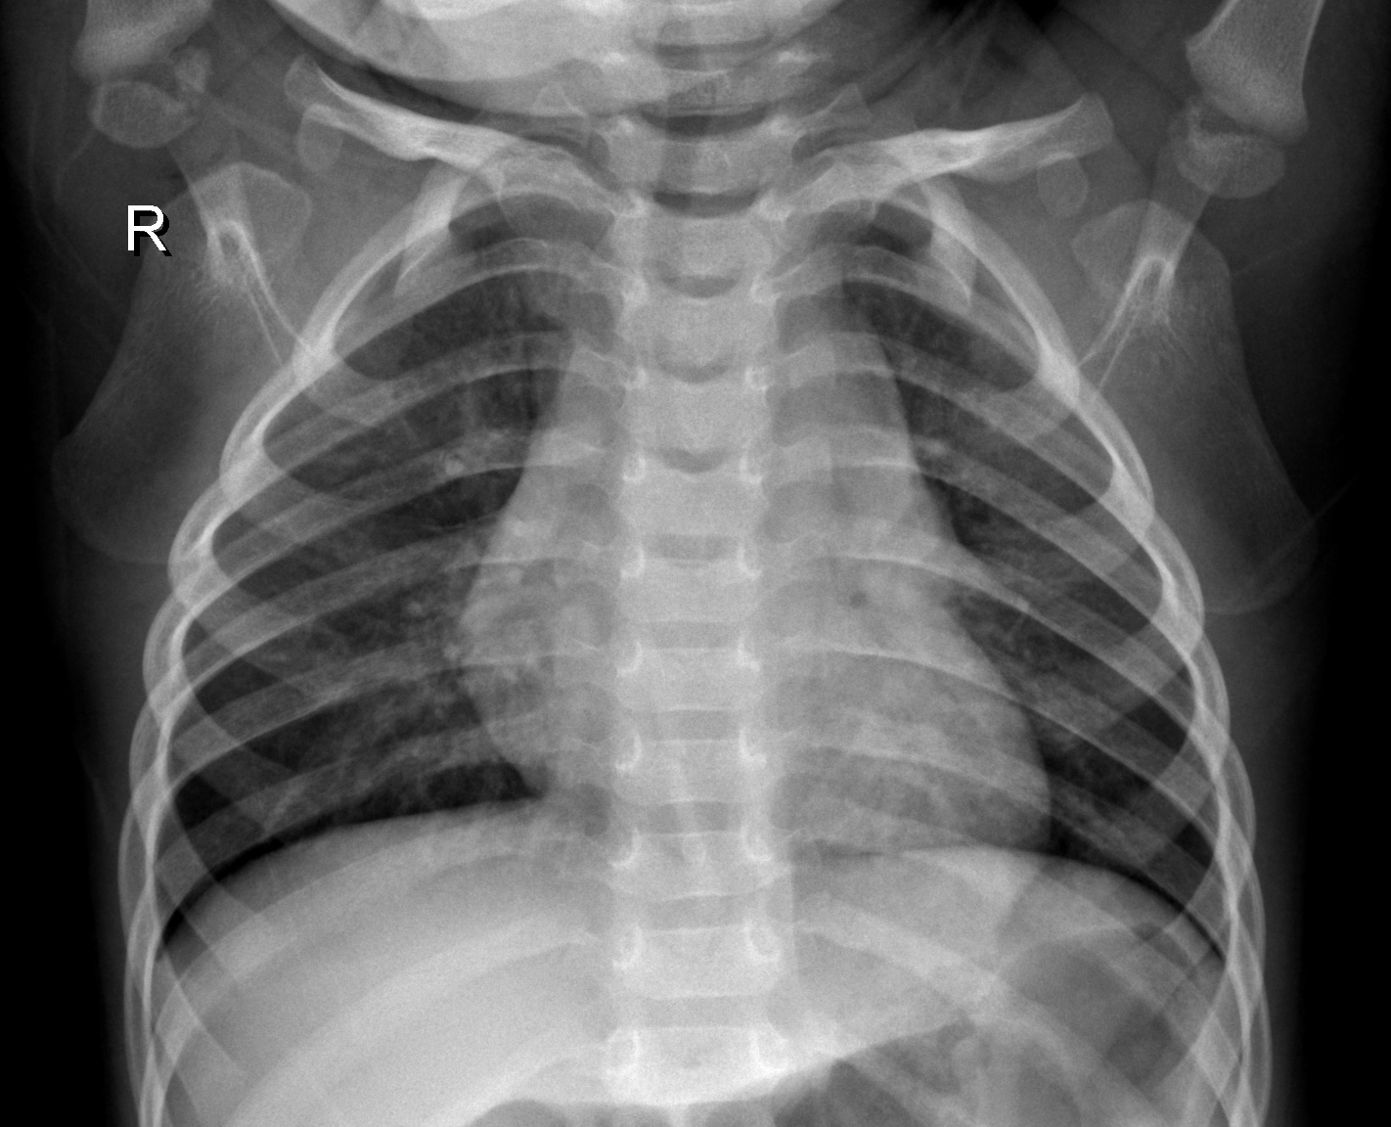
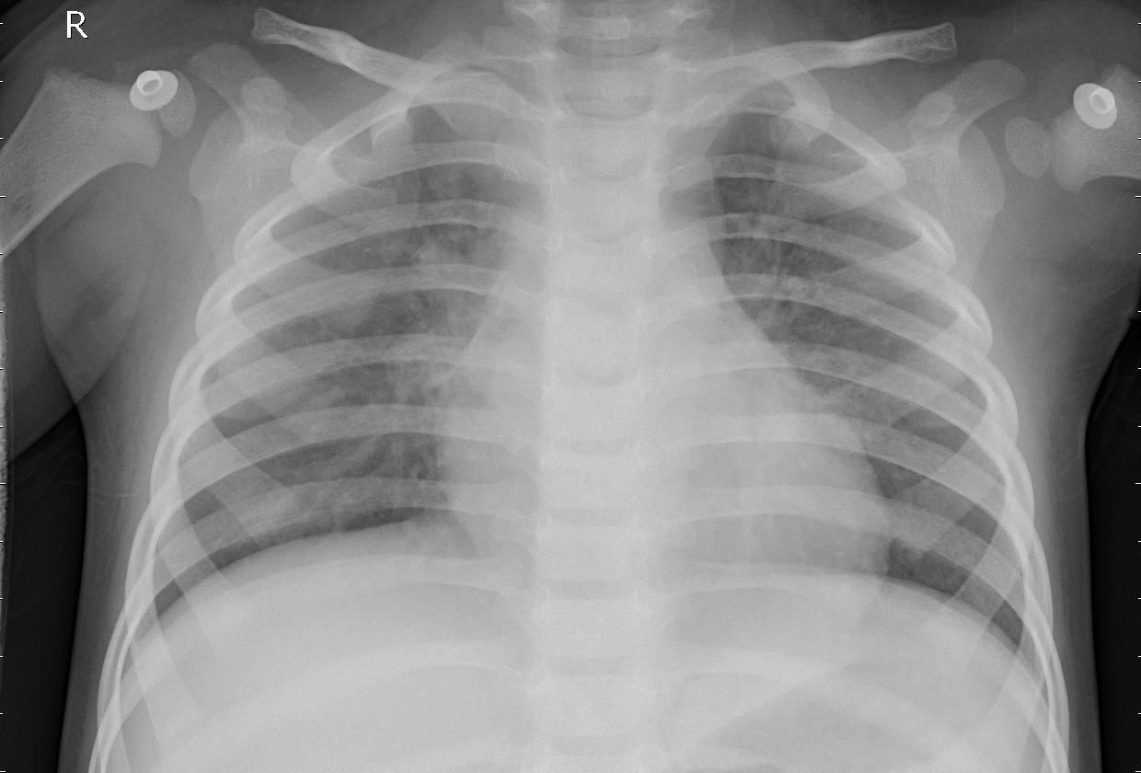
The Data (3/3)
It is a binary dataset
0 – Normal Chest x-Ray
1 – Pneumonia Chest x-Ray
Fig.1: Image of normal chest x-Ray
Fig.2: Image of pneumonia chest x-Ray
6

Slide 7
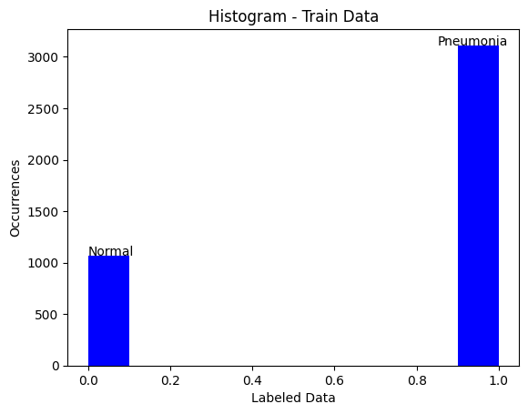
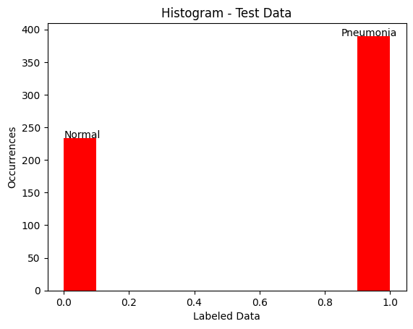
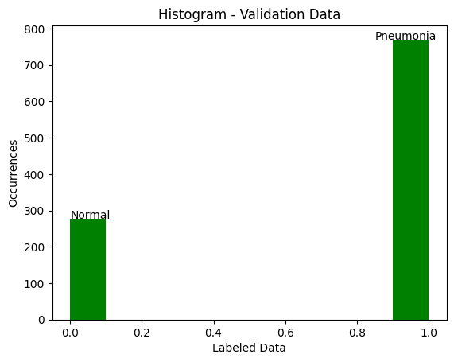
Data Overview (1/3)
Fig.3: Data Distribution of Train Data set
Fig.4: Data Distribution of Test Data set
Fig.5: Data Distribution of Validation Data set
7

Slide 8
Data Overview (2/3)
More pneumonia cases then normal
Training Set: 3100 pneumonia images and 1100 normal images
Test Set: 390 pneumonia images and 230 normal images
Validation Set: 770 pneumonia images and 270 normal images
Data Balanced is necessary
8

Slide 9
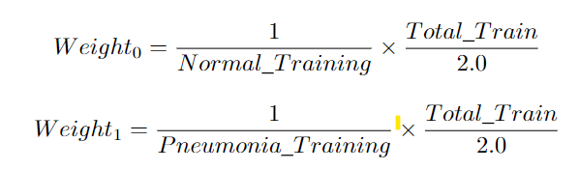

Data Overview (3/3)
Fig.6: Formulas used to balanced the training data set
9

Slide 10
2
The Model
Slight Introduction to Convolutional Neural Network
10

Slide 11

The Model
2 Key Components :
Convolution tool that performers Feature Extracting of an image
Fully connected layers predict class of an image based on the features extracted before
Fig.7: Example of a CNN architecture
11

Slide 12
3
Approach
How we’ve attacked the problem
12

Slide 13
The Approach
Division in 2 mini Projects
1st Mini Project
3 experiments performed
Training Set Unbalanced
Training Set Balanced
Balanced + k-fold Cross Validation
2nd Mini Project
4 experiments performed
Balanced
Data Augmentation
VGG19
InceptionV3
13

Slide 14
Mini Project 1 (1/4)
loss='binary_crossentropy’
optimizer=Adam(learning_rate=0.000001)
METRICS = [
tf.keras.metrics.Precision(name='precision',
tf.keras.metrics.Recall(name='recall'),
]
Description of the CNN model used
5 convolutional blocks comprised of convolutional layer
Flatten layer followed by 4 fully connected layers
Important to notice:
Some of the blocks have dropouts in order to reduce over-fitting
Activation function: Relu; the last layer the activation fuction was Sigmoid duo to this problem being a binary classification problem
14

Slide 15
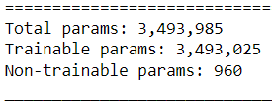
Mini Project 1 (2/4)
1nd Step: Normalize and scale down to [180, 180] the images
2nd Step: Fit the model saving its history
Tested with 25 epochs with 200 steps per epoch
Fig.8: Summary of the parameters of the model
15

Slide 16
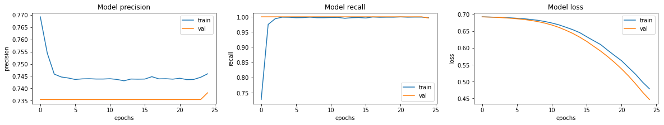
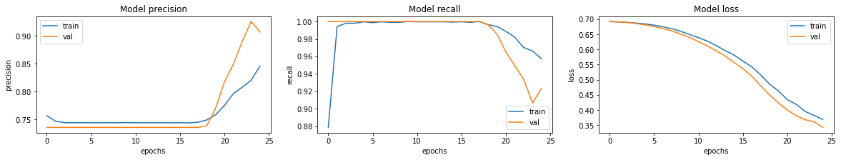
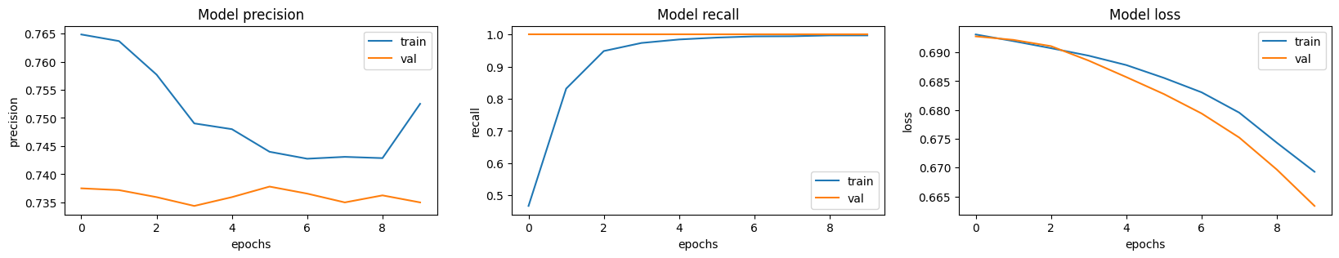
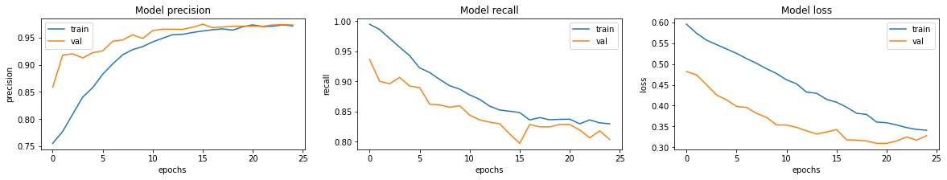
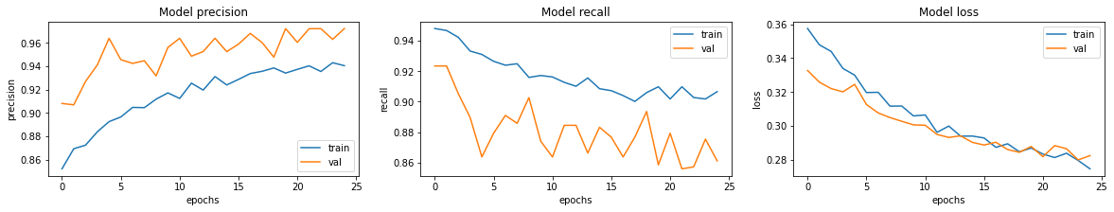
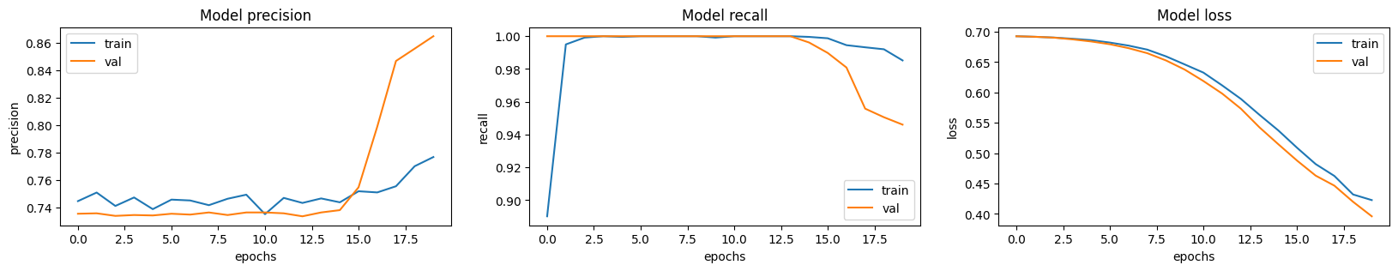
Mini Project 1 (3/4)
Fig.9: Graphics for Unbalanced Data of Mini Project 1 using 25 epochs
Fig.10: Graphics for Balanced Data of Mini Project 1 using 25 epochs
16

Slide 17
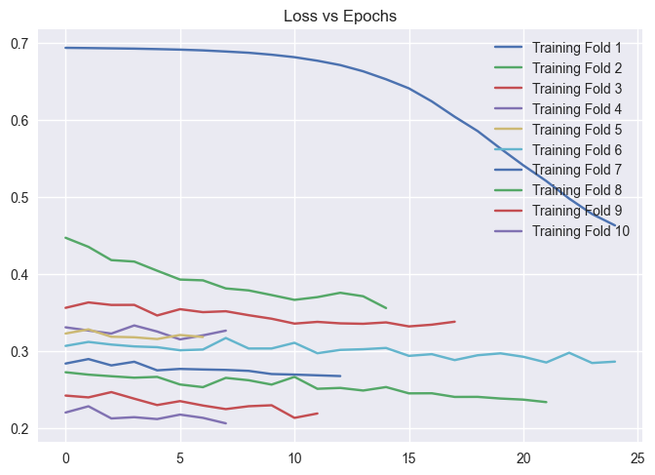
Mini Project 1 (4/4)
Fig.11: Loss for each fold, Balanced + k-fold CV experiment
17

Slide 18
Mini Project 2 (1/4)
loss='binary_crossentropy’
optimizer=Adam(learning_rate=0.000001)
METRICS = [
tf.keras.metrics.Precision(name='precision',
tf.keras.metrics.Recall(name='recall'),
]
Description of the CNN model used
5 convolutional blocks comprised of convolutional layer
Flatten layer followed by 4 fully connected layers
VGG19 and InceptionV3:
Available keras model which are pre-made architectures with pre-trained weights
18

Slide 19
Mini Project 2 (2/4)
loss='binary_crossentropy’
optimizer=Adam(learning_rate=0.000001)
METRICS = [
tf.keras.metrics.Precision(name='precision',
tf.keras.metrics.Recall(name='recall'),
]
For each of the 4 experiments we used 25 epochs and 131 steps per epoch
VGG19 and InceptionV3:
Implemented in linearly stack layers
19

Slide 20
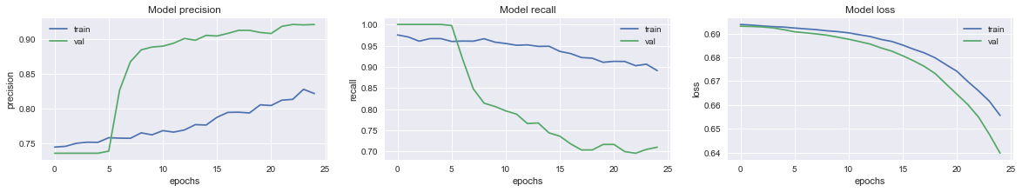
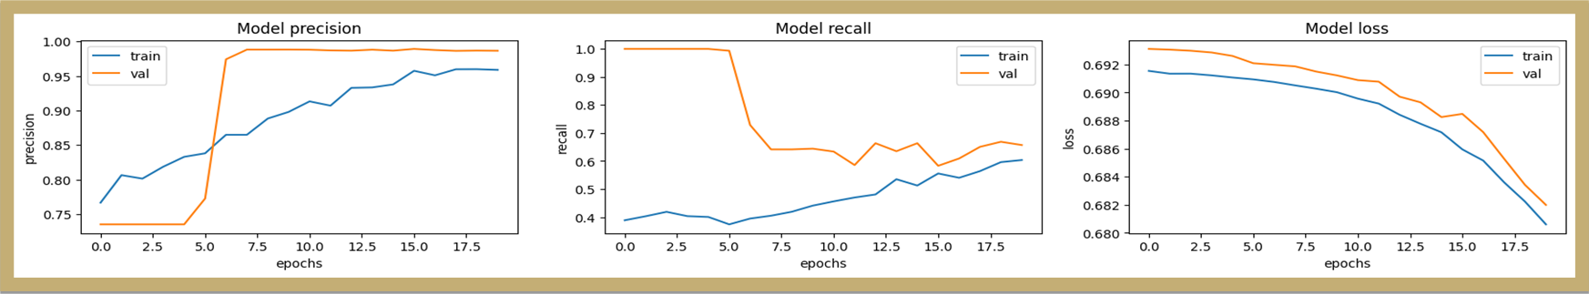
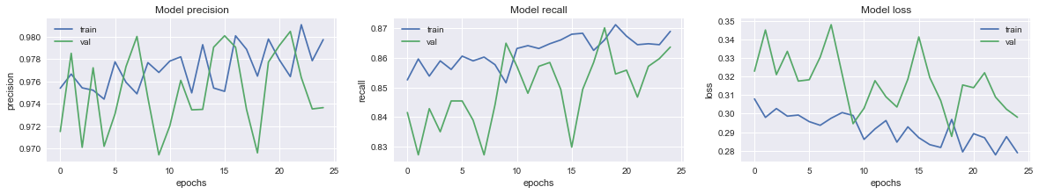
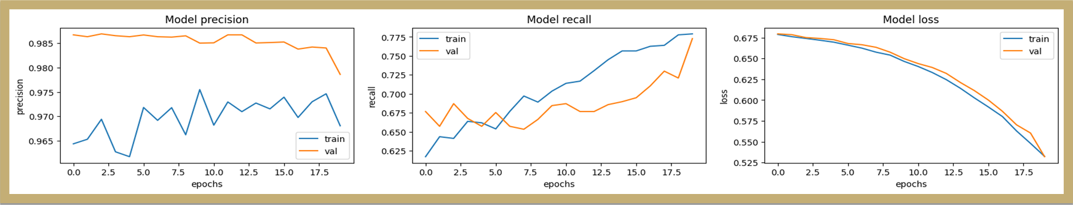
Mini Project 2 (3/4)
Fig.12: Graphics for Balanced Data of Mini Project 2 using 25 epochs
Fig.13: Graphics for Data - Augmentation of Mini Project 2 using 25 epochs
20

Slide 21
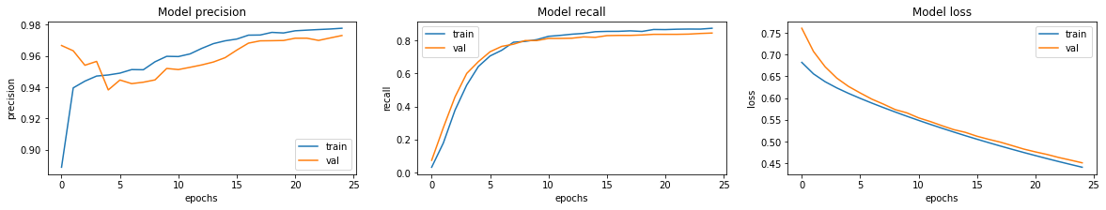
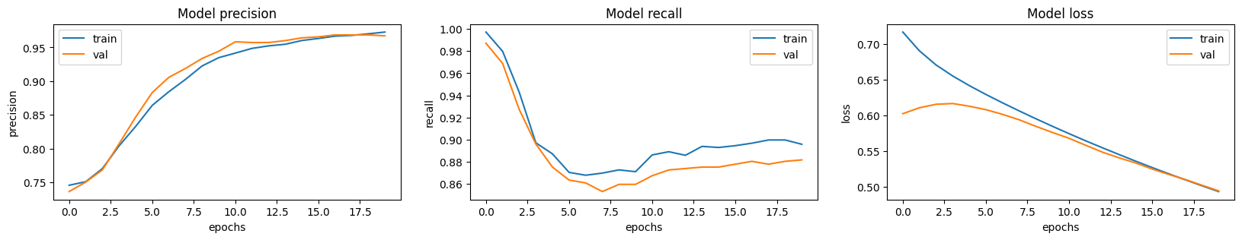
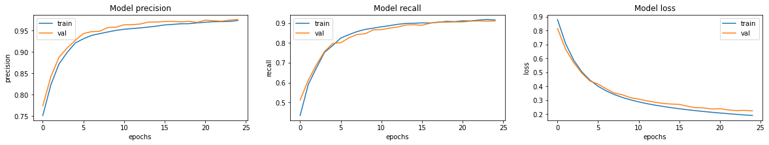
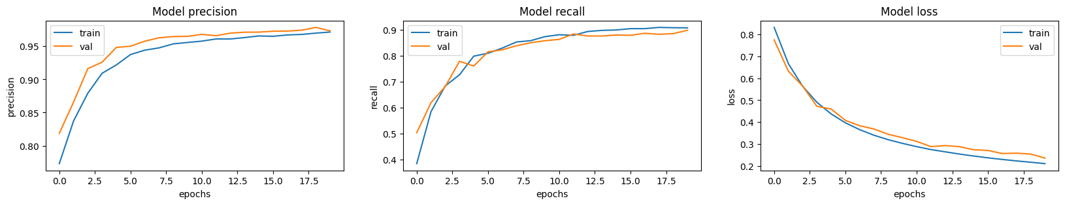
Mini Project 2 (4/4)
Fig.14: Graphics for VGG19 Architecture of Project 2 using 25 epochs
Fig.15: Graphics for InceptionV3 Architecture of Project 2 using 25 epochs
21

Slide 22
4
Results
Performance Metrics, Confusion Matrices and ROC/AUC
22

Slide 23

Results
Since the test set in unbalanced, the accuracy metric is not suitable so, we opted to use the F1 - Score metric to evaluate the performance of the model, calculated as following.
Fig.16: F1 – Score formula
23

Slide 24




Metrics Obtained
Table1: Results obtained for the first mini project using 25 epochs
Table2: Results obtained for the second mini project using 25 epochs
24

Slide 25
ROC Curves & AUC Scores
ROC, Receiver Operator Characteristic, curve is an evaluation metric for binary classification problems. It plots the TPR against the FPR ate various thresholds
AUC, Area Under the Curve, is the measure of the ability of a classifier to distinguish between classes. It is used as a summary of the ROC curve and, the higher the better performance of the model at distinguish between positive and negative classes
25

Slide 26
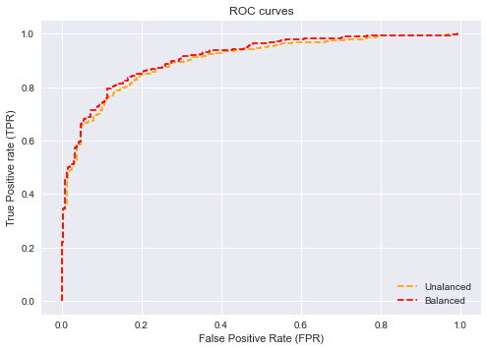
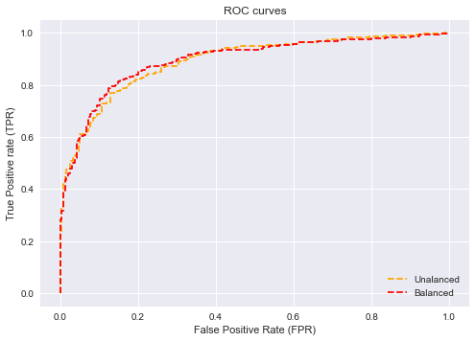
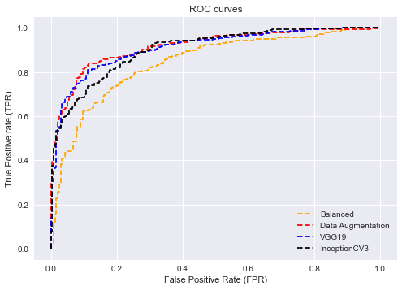
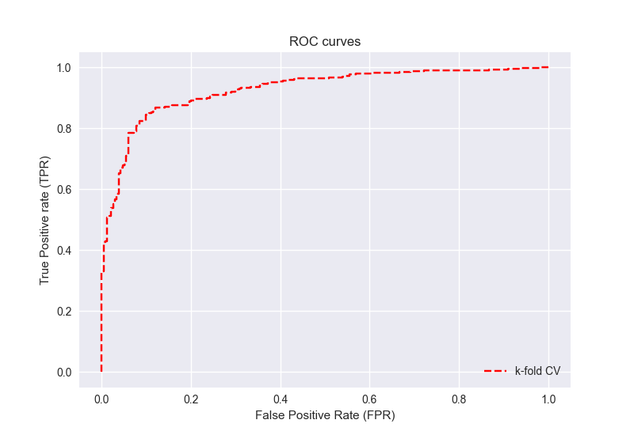
ROC Curves
Fig.17: ROC of Mini Project 1 using 25 epoch
Fig.18: ROC of Mini Project 1 – k-fol CV, 25 epochs & 10 folds
26

Slide 27
ROC Curves
Fig.19: ROC of Mini Project 2 using 25 epoch
27

Slide 28





AUC Scores
Table3: AUC of Mini Project 1 using 25 epoch
Table4: AUC of Mini Project 2 using 25 epoch
28

Slide 29







Confusion Matrices
Table10: Confusion Matrix Dara - Augmentation mini Project 2
Table6: Confusion Matrix Balanced Data mini Project 1
Table8: Confusion Matrix k-fold CV
Data mini Project 1
Table11: Confusion Matrix VGG19 mini Project 2
Table7: Confusion Matrix Unbalanced Data mini Project 1
Table12: Confusion Matrix InceptionV3 mini Project 2
Table9: Confusion Matrix Balanced Data mini Project 2
29

Slide 30


Comparing with other works
Table1: Results obtained for the first mini project using 25 epochs
Table5: Results obtained for others work
Table2: Results obtained for the second mini project using 25 epochs
30

Slide 31
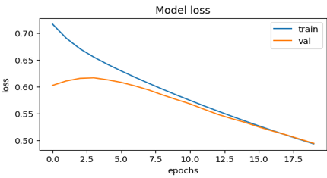
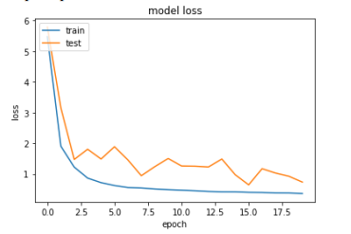
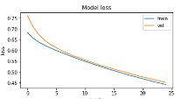
Comparing with other works
Fig.18: Our model loss for the VGG19
Fig.19: Results obtained for others work (VGG19)
31

Slide 32
5
Conclusions
Best model, best approach and future work
32

Slide 33
Conclusion
Working with Unbalanced data gives worst results
The higher the number of steps per epochs the better the results
Cross Validation and Data Augmentation are good ways to improve the model
33

Slide 34
Future Work
Improve the already developed model (ex: working with more steps per epoch, apply CV)
Explore other pre-defined architectures
Study the dependecy of the number of layers in the model performance, i.e., more layers => always better resutls?
34

Slide 35
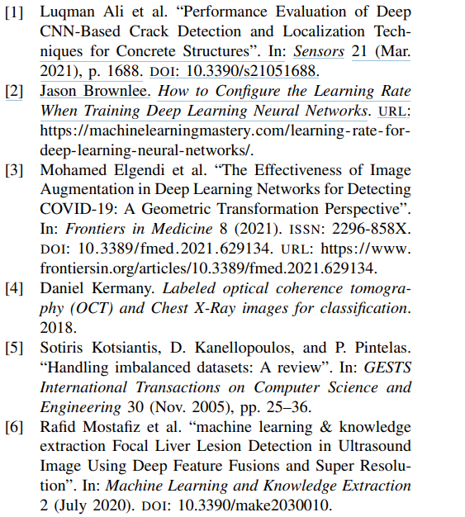
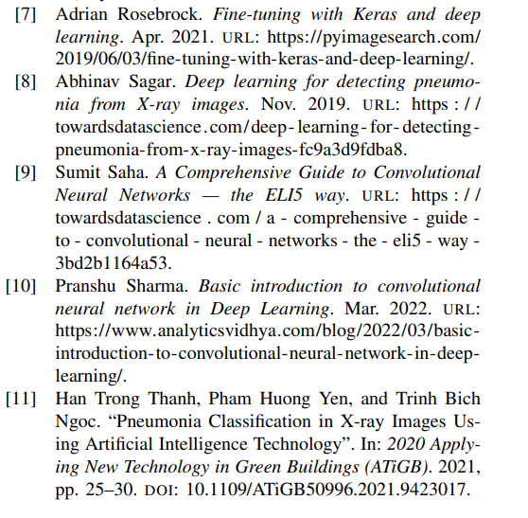

Slide 36

THANKS!
André Fernandes, Nº 97977
Gonçalo Freitas, Nº 98012
University of Aveiro
Artificial Intelligence Applications
Prof: Petia Georgieva
Academic Year 2022/23
Please keep this slide for attribution.

